Slide 1
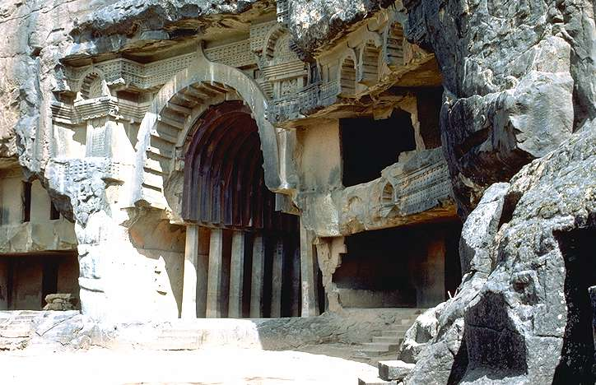
BUDDHIST ARCHITECTURE
Hinayana or Early Phase
200BC – 200AD
Rock cut Chaityas and Viharas
Egs. at Bhaja, Karle, Nasik, Ajanta, Ellora

Slide 2
BUDDHIST
HINAYANA 300 B.C – 100 A.D
MAHAYANA 200 B.C – 150 B.C
Called as Theravada Buddhism.
concept of 4 noble truths & eightfold paths
1.life is suffering 2.The cause of suffering
is desire. 3.the cure for suffering is to
remove desire. 4.to remove desire, follow the eightfold path.
Eightfold Path
Right Knowledge , Thinking , Speech ,
livelihood , Effort , Mindfulness ,
Concentration
It recovered the original form of Buddhism.
Overall goal of Mahayana was to extend religious authority to greater no of people.

Slide 3
BUDDHIST
HINAYANA 300 B.C – 100 A.D
MAHAYANA 200 B.C – 150 B.C
1.Lower vehicle
2.Early form of Buddhism
In which they worshipped belongings of Buddha
3.Buddhism – philosophy
4.There was only one Buddha
Buddha.
1.Greater vehicle
2. They started worshipping the
Buddha statue itself .
3. Buddhism – religion
4. Three bodies - nirmanayaka , sambhogakaya & dharmakaya

Slide 4
MAHAYANA AND HINAYANA PERIOD
DUE TO THE INVASION OF ALEXANDER,WHICH RESULTED IN THE EXTENSION OF THE GREEK EMPIRE UPTO THE PLAINS OF HINDUSTAN,HELLINIC ART AND ARCHITECTURE CAME INTO EXISTENCE.
THE FUSION OF HELLINISTIC ELEMENT WITH BUDDHIST IDOLS RESULTED IN A DISTINCTLY COMPOSITE STYLE OF ARCHITECTURE KNOWN AS GRECO BUDDHIST OF GANDHARA.
GANDARA INCLUDES PESHAWAR,RAWALPINDI,&EASTERN AFGHANISTAN.
THE ARCHITECTURAL STYLE & PLASTIC AND PAINTED DECORATIONS WERE OF SPECIAL CHARACTER.
CONCEPTUALLY INDIAN .TREATMENT AND ART WERE OF GREEK INFLUENCE.
INCLINED TOWARDS DIETIFICATION OF BUDDHA AND STIMULATION OF IMAGE WORSHIP BEGAN.
EXAMPLES OF CHAITYA HALLS
TAKHT-I-BHAI – MAHAYANA TYPE
KARLE-CHAITYA HALL-HINAYANA TYPE

Slide 5
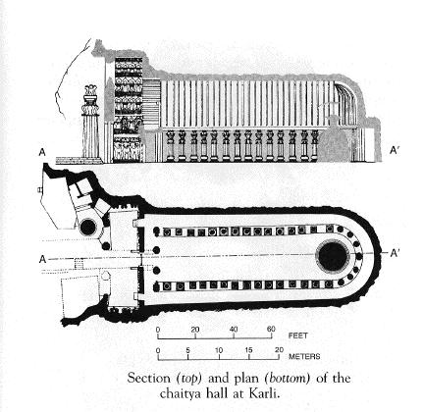
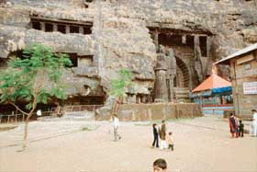
ROCK CUT CHAITYAS
CHAITYA AT KARLE - 100 BC
The Chaitya at Karle marked the culmination of the Hinayana type of Chaitya hall
The exterior is now asymmetrical, and the right side of the hall is totally obscure
It was conceived as a well proportioned and balanced composition of a similar one as the one at Bedsa
Details:
Exterior is a massive propylaeum
Column acts as supports. The 2 large columns in the façade were detached and free standing in front of the entrance with lion capital
Vase shaped base, octagonal shaft
Group of figures and animals on the capital
Railing in front, across entire front
2 large columns-50 ' high in front- free standing lion capital
lion capital- simhastambhas
Each pillar stood on a wide cylinder of rock with its capital and lions supporting the wheel of metal

Slide 6
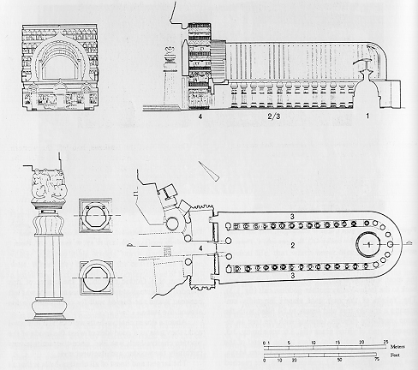
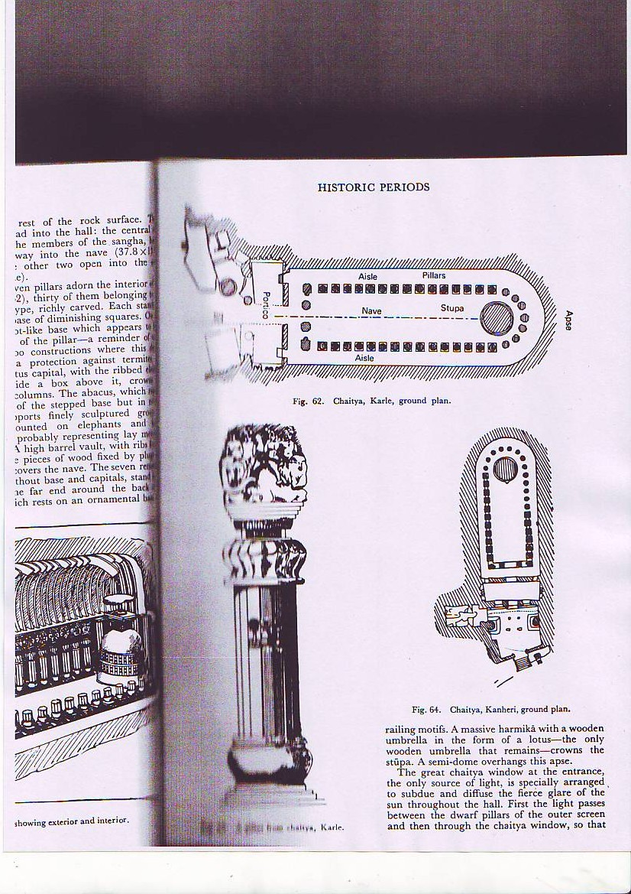
Chaitya hall at karli

Slide 7
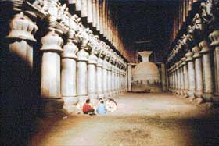
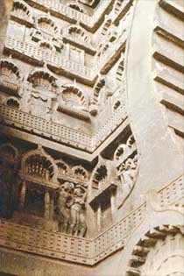
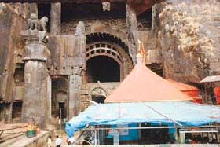
ROCK CUT CHAITYAS
CHAITYA AT KARLE - 100 BC
Façade details:
16 sided columns
fluted abacus
Square base for the animals
Behind the pillars is the Vestibule to the hall
Triple entrance below
Pillared clerestory above
Minstrels gallery as seen by mortise holes - made of wood right across the front. The wooden addition has perished
Access to the gallery by means of a staircase behind lion column on left
Sun window-horse shoe archway
Sculptured figure compositions, decorated arcading
Trellis work
The spandrils and the narrow ends of the vestibule are carved in the rock tiers of chaitya arcading seperated by bands of decorative railings
Below some of the panels are figures in relief
Several of them are Mahayana additions and do not harmonise
The most spirited motif is the series of supporting elephants at the ends, each half life size in high relief originally provided with tusks in ivory
Horse shoe arch/
Kudu

Slide 8
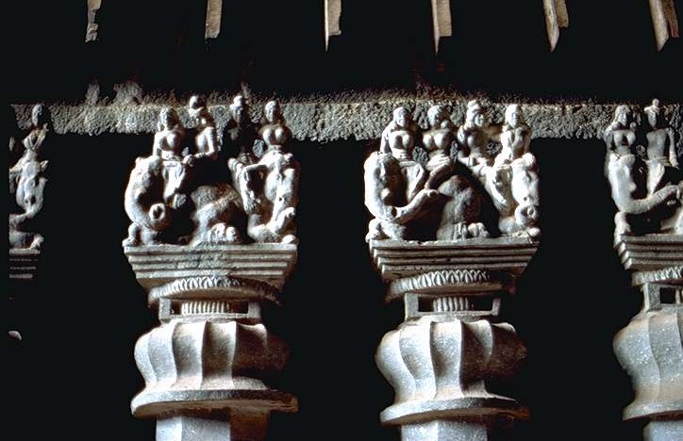
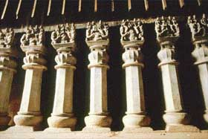
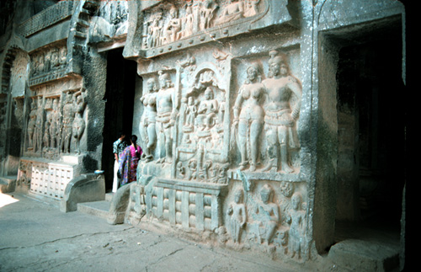
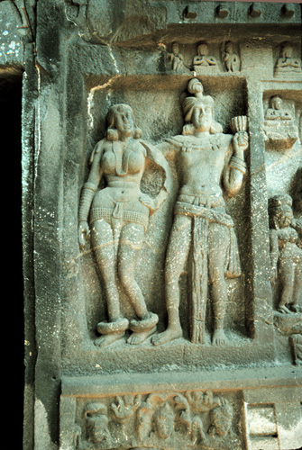
ROCK CUT CHAITYAS
CHAITYA AT KARLE - 100 BC
Entrance Detail:
Presence of 3 doorways, central one for priests
Approached by raised pathway on each side of which the floor
was sunk to form cisterns filled with water (cleansing feet )
Interiors:
124’0”x46.5’x45’
3 main elements:
Colonnade
Vaulting
Sun window
Colonnade:
37 in no., closely spaced( width of the column)
The columns encircling the shaft are octagonal
The other 15 on either side are highly carved and decorated with the theme of the exterior
Each pillar has a vase base on a plinth
Octagonal shaft
Campaniform capital with a spreading abacus
Finished with sculptured statuary- couples atop 2 elephants
Metal trappings and silver and ivory tusks
On the reverse side of these groups horses take the place of elephants

Slide 9
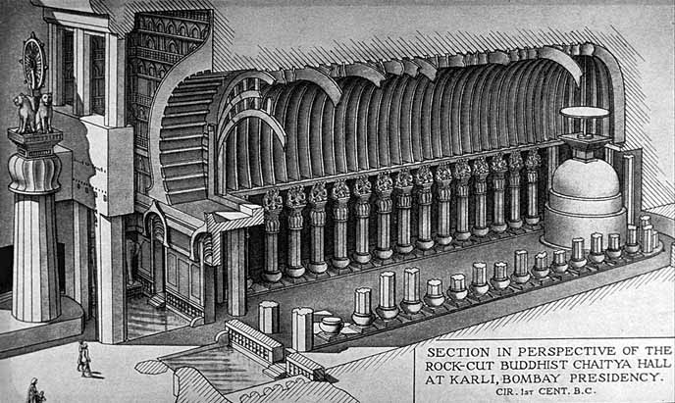
ROCK CUT CHAITYAS
CHAITYA AT KARLE - 100 BC

Slide 10
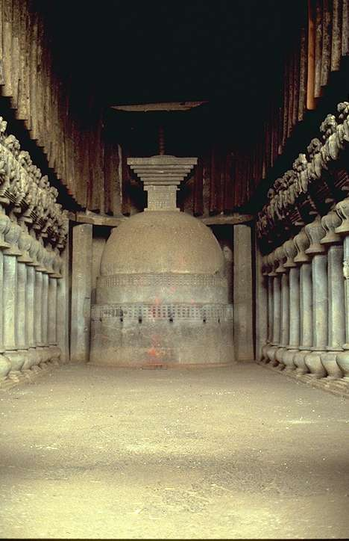
ROCK CUT CHAITYAS
CHAITYA AT KARLE - 100 BC
Vaulting:
High arched vault with projecting ribs of wood attached to the surface by means of plugs or socketed into grooves
The braces are wide planks with a curved outline
They converge to the center at the apsidal end
The wooden accessories seem to have been painted
Under the domical roof is the Stupa
Plain cylindrical base with 2 diminishing tiers
Embellishment in the form of 2 bands of railing (sanchi)
Massive harmika with rail pattern in low relief
Wooden umbrella carved in pattern of a lotus
Lighting – Sun Windows:
The whole system of lighting depends on the sn window in the façade
Illuminated only from one direction

Slide 11
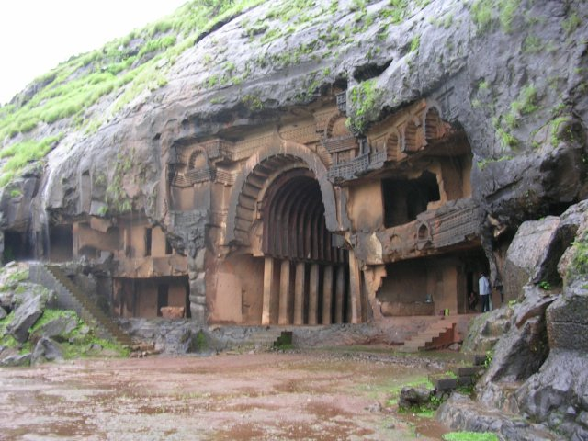
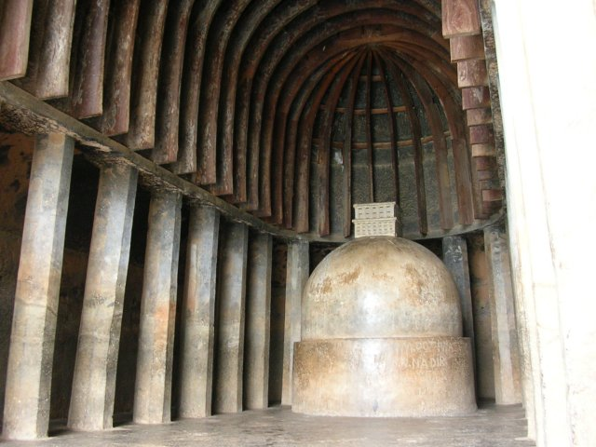
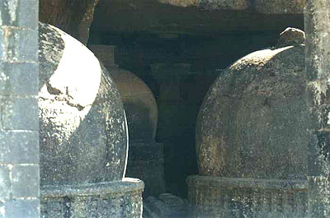
ROCK CUT CHAITYAS

Slide 12
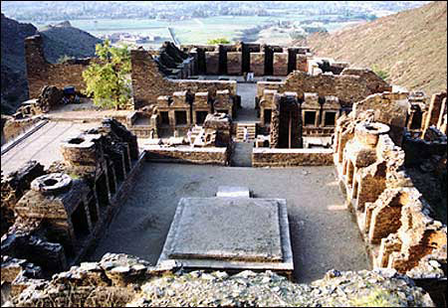
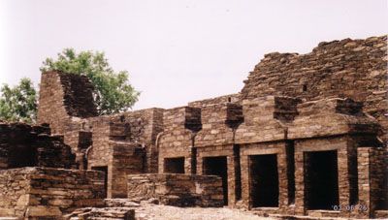
MAHAYANA VIHARAS – 250 BC – 450 AD
Takht I Bahai - Gandhara
Salient Features:
axial plan
Rectangle of 200 ' long
stupa court on the south
monastery on the north
all round terrace for votive stupas, small chapels
west is a conference/ assemble hall
Refectory, Vestment chamber,kitchen servant
quarters
Courtyard-45' x 55'
platform 20 ' square 8 ' high
STUPA
Stupa total height= 50 '
6 tiered umbrella
elegant staircase on North
Circumambulation on top
processional path below
Enclosing the stupa on 3 sides small chapels
not in Hinayana Style but to accommodate the
Budha statues

Slide 13
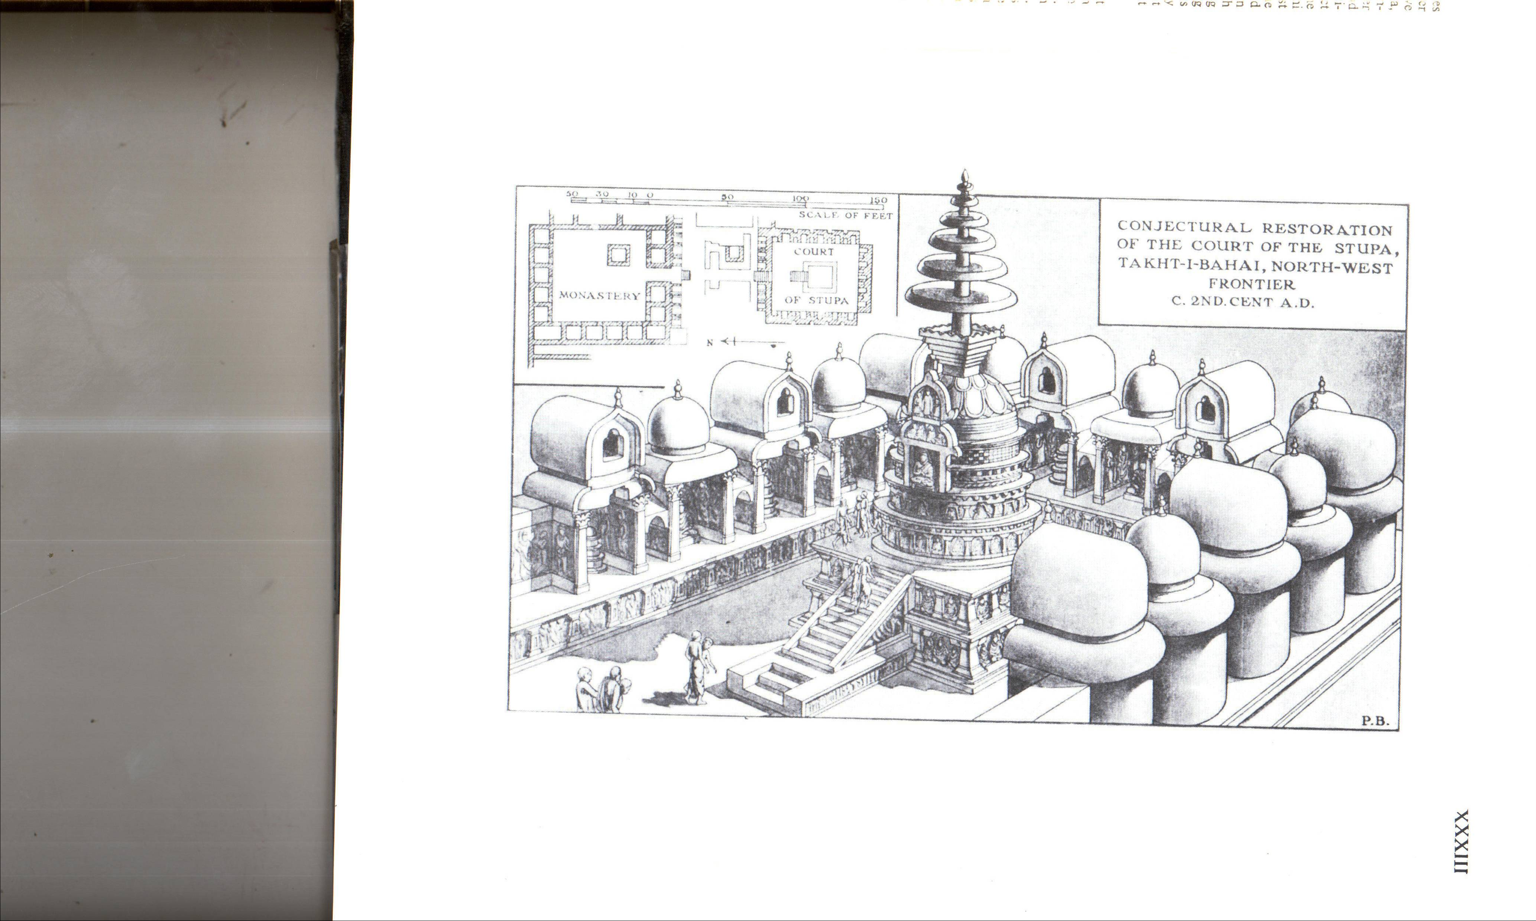
MAHAYANA VIHARAS – 250 BC – 450 AD
Takht I Bahai - Gandhara
Salient Features:
axial plan
Rectangle of 200 ' long
stupa court on the south
monastery on the north
all round terrace for votive stupas, small chapels
west is a conference/ assemble hall
Refectory, Vestment chamber,kitchen servant
quarters
Courtyard-45' x 55'
platform 20 ' square 8 ' high
STUPA
Stupa total height= 50 '
6 tiered umbrella
elegant staircase on North
Circumambulation on top
processional path below
Enclosing the stupa on 3 sides small chapels
not in Hinayana Style but to accommodate the
Budha statues

Slide 14
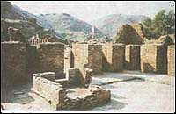
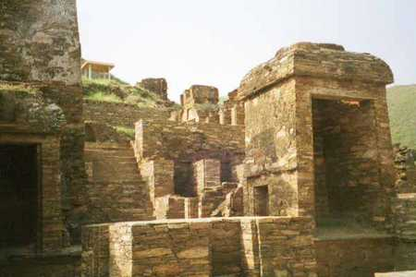
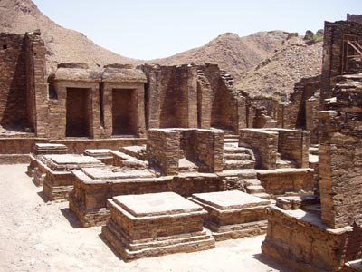
MAHAYANA VIHARAS –
Takht I Bahai - Gandhara
Roof-Cupola alternating with trifoil vault
Cupola beehive hut
Trifoil -conventional chaitya hall
No true arches- corbelling was done
Court of stupa + monastery connected with
flight of steps passing through an open space
Open space contained- stupas and other
elements
Front of the monastery facing court of stupa
had a range of cells containing images
Sangrama- open courtyard with cells all
around,
rooms simple
unadorned walls in between were painted.

Slide 15
MAHAYANA VIHARAS –
Takht I Bahai - Gandhara

Slide 16
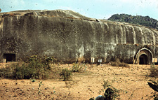
ROCK CUT CAVES AT BARABAR - 3rd c. BC

Slide 17
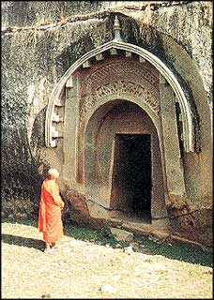
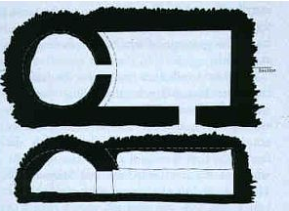
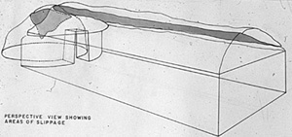
LOMAS RISHI AND SUDAMA AT BARABAR - 3rd c. BC AT NORTHERN GAYA
The Lomas Rishi and the Sudama are cut adjacent to one another on the hill
The interiors are very similar except for the façade of Lomas Rishi which is very ornamental
The doorways of the caves have a sloping jamb and are on the longer side of the chamber
The entrance unlike later caves, is not from the front but from the side, the cave has a vestibule or a path connecting two rooms.
The excavation was carried out this way and not axially due to the configuration of the whale backed hill
Barrel vaulted hall of 32’9” x 19’6” x 12’3”(ht.)
At the end of the chamber entered by an vault ,
interior doorway is a circular cell 19’0” dia. With a hemispherical domed roof 12’3” high
Rectangular Hall
Circular room
Barrel
Domical roof

Slide 18
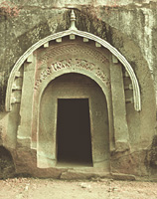
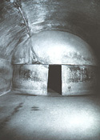
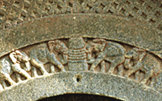
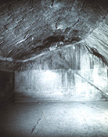
LOMAS RISHI AT BARABAR - 3rd c. BC
Exteriors :
The façade is an accurate reproduction of the gable end of a wooden structure chiselled in rock
2 stout uprights inclined slightly inwards, 13’ high forms the main support
The principal rafters are jointed on the top with the other parallel rafters
On the rafters are fixed the curved roof of 3 laminated planks, the lower extremities of which are kept in place by short tie rods, circular in section (lathe)
The doorway is 7½’ is recessed within a semi circular archway above which are 2 lunettes forming a fanlight

Slide 19
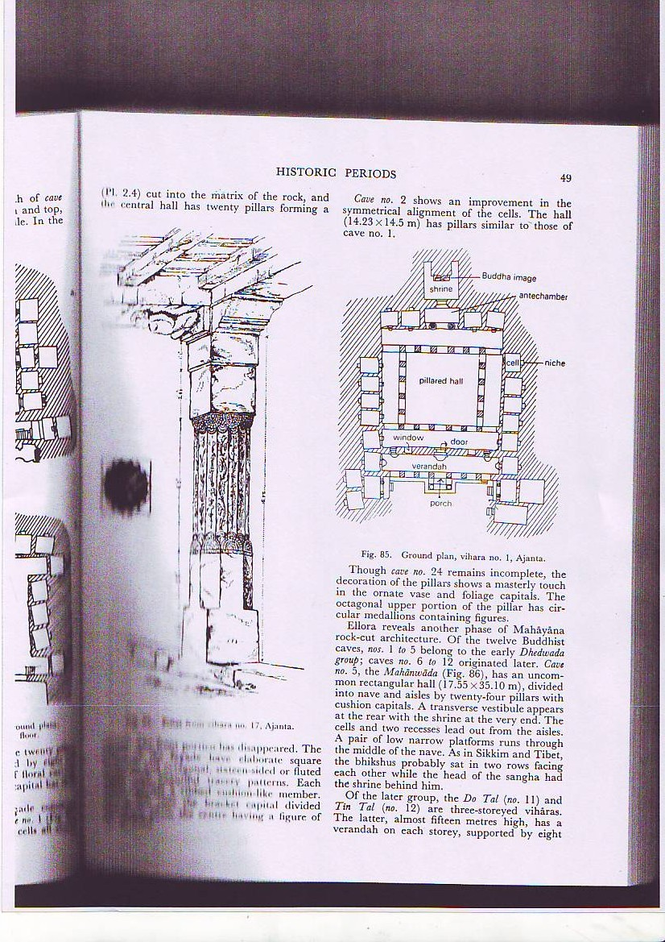
VIHARAS
Viharas or monasteries constructed with brick or excavated from rocks are found in different parts of India.
Usually built to a set plan, they have a hall meant for congregational prayer with a running verandah on three sides or an open courtyard surrounded by a row of cells and a pillared verandah in front.
These cells served as dwelling places for the monks. These monastic buildings built of bricks were self-contained units and had a Chaitya hall or Chaitya mandir attached to a stupa - the chief object of worship.
Some of the important Buddhist viharas are those at Ajanta, Ellora. Nasik, Karle, Kanheri, Bagh and Badami.
The Hinayana viharas found in these places have many interesting features which differentiate them from the Mahayana type in the same regions.

Slide 20
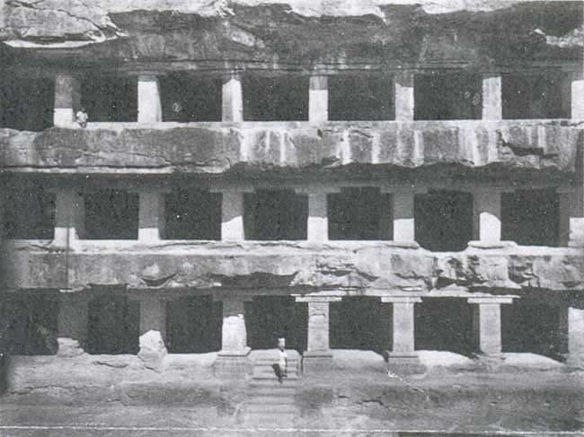

Though plain from the point of view of architecture, they are large ha1ls with cells excavated in the walls on three sides.
The hall has one or more entrances. The small cells, each with a door have one or two stone platforms to serve as beds.
The viharas of Ellora dated 400 AD to 7th century AD are of one, two, and three storeys and are the largest of the type.
Vihara at nasik
Typical vihara plan

